Slide 1
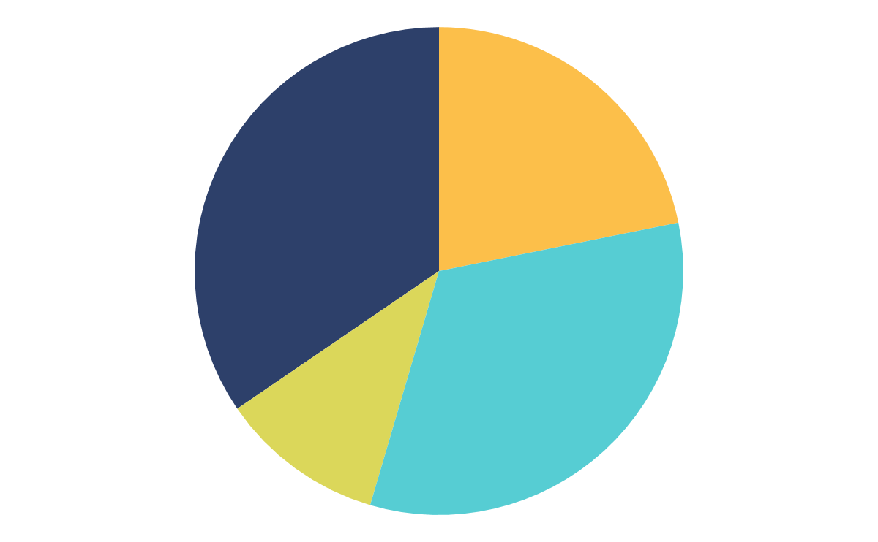
CHEMISTRY THESIS INFOGRAPHICS
This template begins here

Slide 2
About chemistry thesis infographics
This template contains an assortment of complementary infographic resources for the Chemistry Thesis presentation.
These infographics are adapted to the style of the aforementioned presentation, so you can insert them easily and have them completely integrated at once. You just need to do the following:
Select the element that you want to copy
Right-click and choose “Copy”
Go to the slide where you want the element to appear
Right-click and choose “Paste”

Slide 3
Chemistry thesis infographics
VENUS
It has a beautiful name and is the second planet from the Sun
MERCURY
Mercury is the closest planet to the Sun and the smallest one
MARS
It's full of iron oxide dust, which gives the planet its reddish cast
JUPITER
It’s a gas giant and the biggest planet in the Solar System

Slide 4
Chemistry thesis infographics
It’s the closest planet to the Sun and the smallest one in the Solar System
1
Venus has a beautiful name and is the second planet from the Sun
2
Despite being red, it’s a cold place, not hot. It’s full of iron oxide dust
3

Slide 5
Chemistry thesis infographics
MERCURY
MARS
Mercury is the closest planet to the Sun and the smallest one in the Solar System—it’s only a bit larger than the Moon
Despite being red, Mars is a cold place, not hot. It’s full of iron oxide dust, which gives the planet its reddish cast

Slide 6
Chemistry thesis infographics
Mercury is the closest planet to the Sun
MERCURY
Despite being red, Mars is a cold place, not hot
MARS
Jupiter is a gas giant and the biggest planet
JUPITER
Neptune is the farthest planet from the Sun
NEPTUNE

Slide 7
Chemistry thesis infographics
18%
Jupiter is a gas giant and the biggest planet in the Solar System. It's the fourth-brightest object in the night sky. It was named after a Roman god
20%
It’s a gas giant and has several rings. It's composed mostly of hydrogen and helium. It was named after the Roman god of wealth and agriculture
25%
Mercury is the closest planet to the Sun and the smallest one in the Solar System. The planet’s name has nothing to do with the liquid metal
15%
It has a beautiful name and is the second planet from the Sun. It’s terribly hot. It’s the second-brightest natural object in the night sky after the Moon

Slide 8
Chemistry thesis infographics
MERCURY
VENUS
MARS
It’s the closest planet to the Sun and the smallest one in the Solar System
Venus has a beautiful name and is the second planet from the Sun
Despite being red, Mars is a cold place, not hot. It’s full of iron oxide dust

Slide 9
Chemistry thesis infographics
70%
60%
50%
30%
It’s the closest planet to the Sun and the smallest one in the Solar System
Despite being red, Mars is a cold place, not hot. It’s full of iron oxide dust
Venus has a beautiful name and is the second planet from the Sun
Earth is the third planet from the Sun and the only one that harbors life

Slide 10
Chemistry thesis infographics
VENUS
SATURN
It has a beautiful name and is the second planet from the Sun
It was named after the Roman god of wealth and agriculture
MARS
NEPTUNE
It's full of iron oxide dust, which gives the planet its reddish cast
It's also the fourth-largest object by diameter in the Solar System
MERCURY
JUPITER
Mercury is the closest planet to the Sun and the smallest one
It’s a gas giant and the biggest planet in the Solar System

Slide 11
Chemistry thesis infographics
75%
50%
25%
Mercury is the closest planet to the Sun and the smallest one in the Solar System
Despite being red, Mars is a cold place, not hot. It’s full of iron oxide dust
Venus has a beautiful name and is the second planet from the Sun

Slide 12
Chemistry thesis infographics
1
2
3
4
It’s the closest planet to the Sun and the smallest one in the Solar System
Despite being red, Mars is a cold place, not hot. It’s full of iron oxide dust
Venus has a beautiful name and is the second planet from the Sun
Earth is the third planet from the Sun and the only one that harbors life

Slide 13
Chemistry thesis infographics
1
Mercury is the closest planet to the Sun and the smallest one
2
It has a beautiful name and is the second planet from the Sun
3
It was named after the Roman god of wealth and agriculture

Slide 14
Chemistry thesis infographics
It’s a gas giant and the biggest planet in the Solar System
1
It’s a gas giant and has several rings. It's composed mostly of hydrogen
2
Mercury is the closest planet to the Sun and the smallest one
3
It has a beautiful name and is the second planet from the Sun
4

Slide 15
Chemistry thesis infographics
34.5%
21.8%
It has a beautiful name and is the second planet from the Sun
It’s the third planet from the Sun and where we all live on
10.9%
32.7%
Saturn is the ringed planet and one of the four gas giants
It's full of iron oxide dust, which gives the planet its reddish cast
If you want to modify this graph, click on it, follow the link, change the data and replace it

Slide 16
Chemistry thesis infographics
1
Mercury is the closest planet to the Sun and the smallest one
2
It has a beautiful name and is the second planet from the Sun
3
It was named after the Roman god of wealth and agriculture

Slide 17
Chemistry thesis infographics
VENUS
SATURN
It has a beautiful name, but it’s terribly hot
Saturn is a gas giant and has several rings
MARS
NEPTUNE
Despite being red, Mars is actually a cold planet
Neptune is the farthest planet from the Sun
MERCURY
JUPITER
Mercury is the closest planet to the Sun
Jupiter is a gas giant and the biggest planet

Slide 18
Chemistry thesis infographics
Earth is the third planet from the Sun and the only one that harbors life
Despite being red, Mars is a cold place, not hot. It’s full of iron oxide dust
1
2
3
4
It’s the closest planet to the Sun and the smallest one in the Solar System
Venus has a beautiful name and is the second planet from the Sun

Slide 19
Chemistry thesis infographics
JUPITER
VENUS
It’s a gas giant and the biggest planet in the Solar System
Venus has a beautiful name, but it’s terribly hot
MARS
MERCURY
Despite being red, Mars is actually a cold planet
Mercury is the closest planet to the Sun and the smallest one

Slide 20
Chemistry thesis infographics
20%
Jupiter is a gas giant and the biggest planet in the Solar System. It's the fourth-brightest object in the night sky. It was named after a Roman god
45%
It’s a gas giant and has several rings. It's composed mostly of hydrogen and helium. It was named after the Roman god of wealth and agriculture
35%
It has a beautiful name and is the second planet from the Sun. It’s terribly hot. It’s the second-brightest natural object in the night sky after the Moon

Slide 21
Chemistry thesis infographics
MERCURY
Mercury is the closest planet to the Sun and the smallest one
MARS
It's full of iron oxide dust, which gives the planet its reddish cast
VENUS
It has a beautiful name and is the second planet from the Sun
SATURN
It was named after the Roman god of wealth and agriculture

Slide 22
Chemistry thesis infographics
1
2
3
4
MERCURY
VENUS
MARS
SATURN
Mercury is the closest planet to the Sun and the smallest one
It has a beautiful name and is the second planet from the Sun
It's full of iron oxide dust, which gives the planet its reddish cast
It was named after the Roman god of wealth and agriculture

Slide 23
Chemistry thesis infographics
80%
Despite being red, Mars is a cold place, not hot. It’s full of iron oxide dust, which gives the planet its reddish cast
Mercury is the closest planet to the Sun and the smallest one in the Solar System—it’s only a bit larger than the Moon
60%

Slide 24
Chemistry thesis infographics
Jupiter is a gas giant and also the biggest planet in the Solar System
Venus has a beautiful name and is the second planet from the Sun
It’s the closest planet to the Sun and the smallest one in the Solar System
Saturn is a gas giant, composed mostly of hydrogen and helium

Slide 25
Chemistry thesis infographics
Despite being red, Mars is actually a cold planet
It’s the closest planet to the Sun and the smallest one
MARS
MERCURY
VENUS
SATURN
It has a beautiful name, but it’s terribly hot
Saturn is a gas giant and has several rings

Slide 26
Chemistry thesis infographics
Mercury is the smallest planet in the Solar System
Despite being red, Mars is actually a cold place
Jupiter is the biggest planet in the Solar System
It was named after the Roman god of wealth
Venus has a beautiful name, but it’s terribly hot
It's also the fourth-largest object by diameter
Earth is the beautiful planet we live on
This planet's name has nothing to do with the metal

Slide 27
Chemistry thesis infographics
VENUS
SATURN
It has a beautiful name and is the second planet from the Sun
It was named after the Roman god of wealth and agriculture
MARS
NEPTUNE
It's full of iron oxide dust, which gives the planet its reddish cast
It's also the fourth-largest object by diameter in the Solar System
MERCURY
JUPITER
Mercury is the closest planet to the Sun and the smallest one
It is a gas giant and the biggest planet in the Solar System

Slide 28
Chemistry thesis infographics
1
Mercury is the closest planet to the Sun
MERCURY
2
Despite being red, Mars is a cold place, not hot
MARS
3
Jupiter is a gas giant and the biggest planet
JUPITER
4
Neptune is the farthest planet from the Sun
NEPTUNE

Slide 29
Chemistry thesis infographics
MERCURY
VENUS
MARS
Mercury is the closest planet to the Sun and the smallest one
It has a beautiful name and is the second planet from the Sun
It's full of iron oxide dust, which gives the planet its reddish cast

Slide 30
Chemistry thesis infographics
MARS
It’s full of iron oxide dust, which gives the planet its reddish cast
MERCURY
It’s the closest planet to the Sun and the smallest one in the Solar System

Slide 31
Chemistry thesis infographics
75%
50%
25%
80%
MARS
JUPITER
MERCURY
VENUS
Despite being red, Mars is actually a cold planet
Jupiter is a gas giant and the biggest planet
Mercury is the closest planet to the Sun
It has a beautiful name, but it’s terribly hot

Slide 32
Chemistry thesis infographics
80%
It’s a gas giant and has several rings. It's composed mostly of hydrogen and helium
45%
Mercury is the closest planet to the Sun and the smallest one in the Solar System. It was named after a god
20%
Despite being red, it’s actually a cold place. It is full of iron oxide dust, giving the planet its characteristic reddish cast

Slide 33
Instructions for use (free users)
In order to use this template, you must credit Slidesgo by keeping the Thanks slide.
You are allowed to:
Modify this template.
Use it for both personal and commercial purposes.
You are not allowed to:
Sublicense, sell or rent any of Slidesgo Content (or a modified version of Slidesgo Content).
Distribute this Slidesgo Template (or a modified version of this Slidesgo Template) or include it in a database or in any other product or service that offers downloadable images, icons or presentations that may be subject to distribution or resale.
Use any of the elements that are part of this Slidesgo Template in an isolated and separated way from this Template.
Delete the “Thanks” or “Credits” slide.
Register any of the elements that are part of this template as a trademark or logo, or register it as a work in an intellectual property registry or similar.
For more information about editing slides, please read our FAQs or visit Slidesgo School:
https://slidesgo.com/faqs and https://slidesgo.com/slidesgo-school

Slide 34
Instructions for use (premium users)
In order to use this template, you must be a Premium user on Slidesgo.
You are allowed to:
Modify this template.
Use it for both personal and commercial purposes.
Hide or delete the “Thanks” slide and the mention to Slidesgo in the credits.
Share this template in an editable format with people who are not part of your team.
You are not allowed to:
Sublicense, sell or rent this Slidesgo Template (or a modified version of this Slidesgo Template).
Distribute this Slidesgo Template (or a modified version of this Slidesgo Template) or include it in a database or in any other product or service that offers downloadable images, icons or presentations that may be subject to distribution or resale.
Use any of the elements that are part of this Slidesgo Template in an isolated and separated way from this Template.
Register any of the elements that are part of this template as a trademark or logo, or register it as a work in an intellectual property registry or similar.
For more information about editing slides, please read our FAQs or visit Slidesgo School:
https://slidesgo.com/faqs and https://slidesgo.com/slidesgo-school

Slide 35
Infographics
You can add and edit some infographics to your presentation to present your data in a visual way.
Choose your favourite infographic and insert it in your presentation using Ctrl C + Ctrl V or Cmd C + Cmd V in Mac.
Select one of the parts and ungroup it by right-clicking and choosing “Ungroup”.
Change the color by clicking on the paint bucket.
Then resize the element by clicking and dragging one of the square-shaped points of its bounding box (the cursor should look like a double-headed arrow). Remember to hold Shift while dragging to keep the proportions.
Group the elements again by selecting them, right-clicking and choosing “Group”.
Repeat the steps above with the other parts and when you’re done editing, copy the end result and paste it into your presentation.
Remember to choose the “Keep source formatting” option so that it keeps the design. For more info, please visit Slidesgo School.

